Slide 1
Dependency Injection

Slide 2
Dependency injection
Azure function V2
Microsoft.NET.Sdk.Functions >= 1.0.28
Loose the static (class and methods)
Constructor injection!
Same as DI in ASP.Net core
Already provided services:
Microsoft.Extensions.Configuration.IConfiguration
Microsoft.Azure.WebJobs.Host.Executors.IHostIdProvider

Slide 3
DI - scopes
3 scopes:
Singleton – Created once, on first request or when created before registration.
Scoped – Created once per client request (connection).
Trancient – created on each request.
See https://docs.microsoft.com/en-us/aspnet/core/fundamentals/dependency-injection

Slide 4
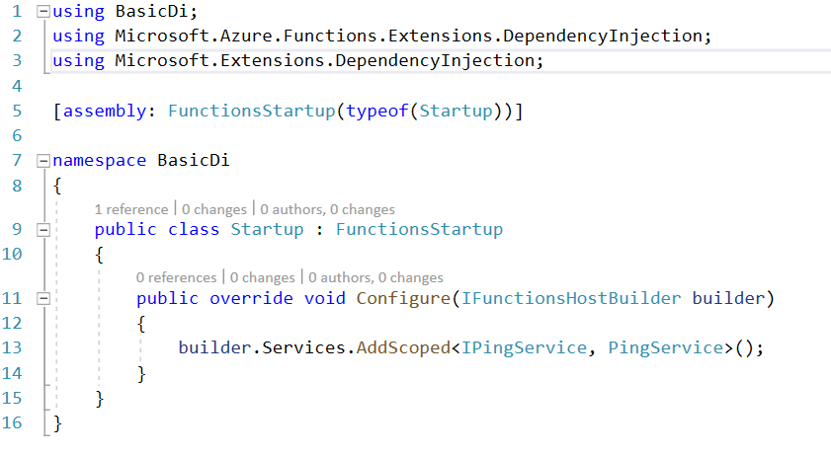
DI extension
NuGet: Microsoft.Azure.Functions.Extensions
Makes dependency registrations easier
Provides IServiceCollection on IFunctionHostBuilder

Slide 5

DI - HttpClient
Plain HttpClient
NamedHttpClient
Preconfigure
Set retry policies (Polly)

